Slide 1
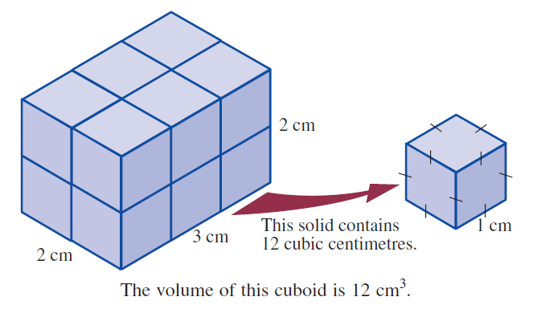
24
7
30
Topic: Volume
Date
EQ – How do you find the volume of an object?
Volume is the amount of space there is inside a 3d object.
Think of a lunch container and ask yourself how many 1cm cubes could fit inside it. The answer is the volume of the container.

Slide 2
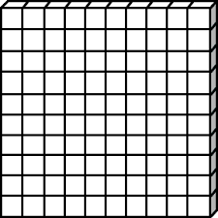
To find the volume of a rectangular prism:
1.
10cm
10cm
10cm

Slide 3
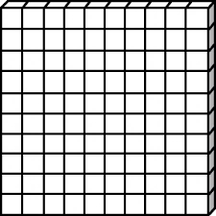
To find the volume of a rectangular prism:
1. Calculate the area of the “face” = 100cm²
2. Multiple that area by how many rows it goes back
Area= 10 x 10cm = 100cm²
10cm
10cm
10cm

Slide 4
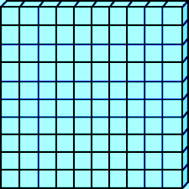
To find the volume of a rectangular prism:
1. Calculate the area of the “face” = 100cm²
2. Multiple that area by how many rows it goes back
Volume = 100cm² x 1cm back
= 100cm³
10cm
10cm
10cm

Slide 5
To find the volume of a rectangular prism:
1. Calculate the area of the “face” = 100cm²
2. Multiple that area by how many rows it goes back
Volume = 100cm² x 2cm back
= 200cm³
10cm
10cm
10cm

Slide 6
To find the volume of a rectangular prism:
1. Calculate the area of the “face” = 100cm²
2. Multiple that area by how many rows it goes back
Volume = 100cm² x 3cm back
= 300cm³
10cm
10cm
10cm

Slide 7
To find the volume of a rectangular prism:
1. Calculate the area of the “face” = 100cm²
2. Multiple that area by how many rows it goes back
Volume = 100cm² x 4cm back
= 400cm³
10cm
10cm
10cm

Slide 8
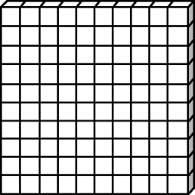
To find the volume of a rectangular prism:
1. Calculate the area of the “face” = 100cm²
2. Multiple that area by how many rows it goes back
Volume = 100cm² x 5cm back
= 500cm³
10cm
10cm
10cm

Slide 9
To find the volume of a rectangular prism:
1. Calculate the area of the “face” = 100cm²
2. Multiple that area by how many rows it goes back
Volume = 100cm² x 6cm back
= 600cm³
10cm
10cm
10cm

Slide 10
To find the volume of a rectangular prism:
1. Calculate the area of the “face” = 100cm²
2. Multiple that area by how many rows it goes back
Volume = 100cm² x 7cm back
= 700cm³
Volume is in units³
10cm
10cm
10cm

Slide 11
24
7
30
Topic: Volume
Date
EQ – How do you find the volume of an object?
Volume is the amount of space there is inside a 3d object.
Think of a lunch container and ask yourself how many 1cm cubes could fit inside it. The answer is the volume of the container.
For any prism or cylinder
Volume = area of the face x the length of the object

Slide 12
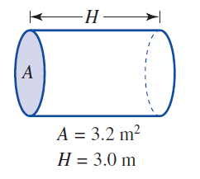
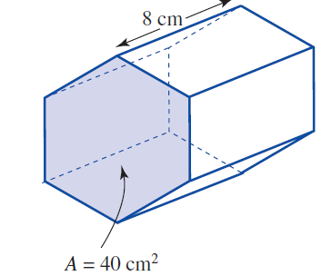
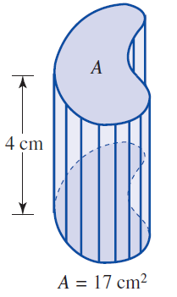
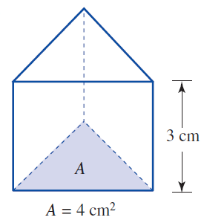

Slide 13
Volume = Area x length
= 40cm² x 8cm
= 320cm³

Slide 14
Volume = Area x length
= 40cm² x 8cm
= 320cm³
Volume = Area x length
= 4cm² x 3cm
= 12cm³

Slide 15
Volume = Area x length
= 40cm² x 8cm
= 320cm³
Volume = Area x length
= 3.2m² x 3m
= 9.6m³
Volume = Area x length
= 4cm² x 3cm
= 12cm³

Slide 16
Volume = Area x length
= 40cm² x 8cm
= 320cm³
Volume = Area x length
= 3.2m² x 3m
= 9.6m³
Volume = Area x length
= 4cm² x 3cm
= 12cm³
Volume = Area x length
= 17cm² x 4cm
= 68cm³

Slide 17
